Slide 1
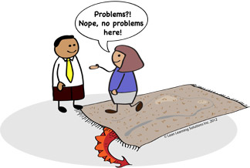

Slide 2
First thing required is
The courage To listen
the problem
Especially to the key
stakeholders / Business

Slide 3
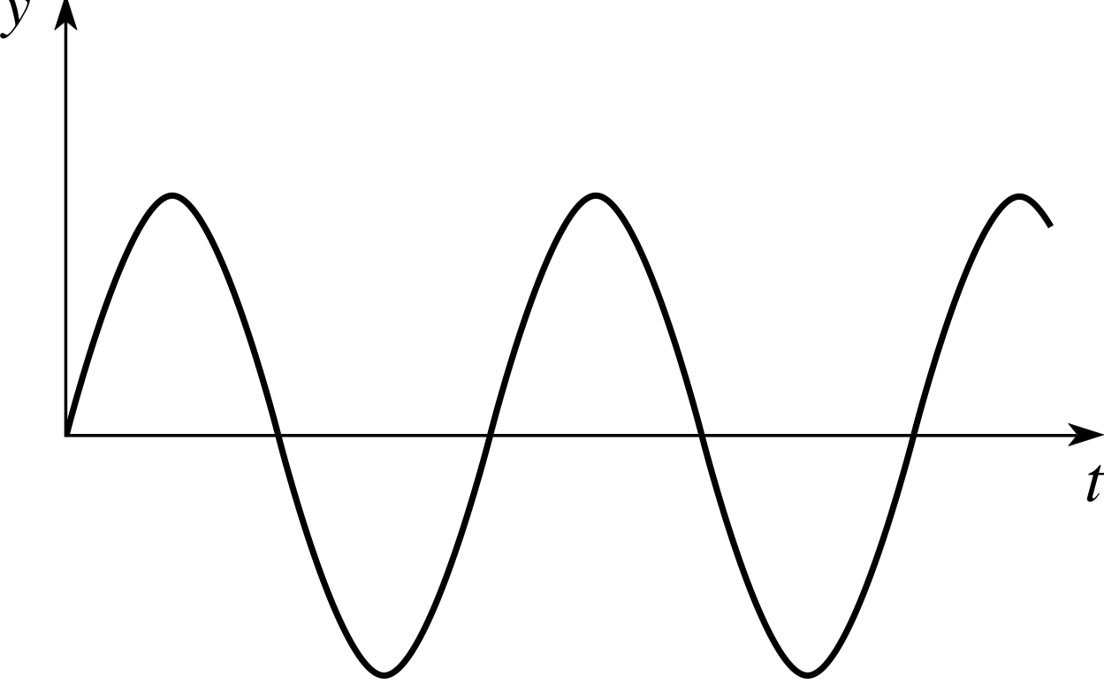
Sine Wave Theorem of Productivity

Slide 4
Lets discuss about what
to do in NEXT Build
(Low Productivity
Period)
Dev & QA
(Good Productivity Period)
UAT
(Low Productivity
Period)
Dev & QA
(Good Productivity Period)
Go Live & Immediate
Problem addressing period
(Low Productivity
Period)

Slide 5
Inefficient Delivery Process

Slide 6
Linear / Batch wise delivery
4-6Weeks
4-6Weeks
4-6Weeks
4-6Weeks
Clint A Delivered
Clint B Delivered
Clint C Delivered
Clint A Delivered
Only after 4 months PLUS
Parallel Delivery
Clint A Delivered
Merged
Challenges
Clint A Delivered

Slide 7
Late checkins and late code feedbacks

Slide 8
Branching/Merging is inconsistent &
unpredictable

Slide 9
Deployments are performed manually

Slide 10
There are no test scripts for manual testing,
testing is done on individual intelligence

Slide 11
Environments are provisioned manually
It takes roughly 5 days for a project to
create a new environment

Slide 12
Challenges
Long Delivery Cycle even for small items
Repetitive Regression Testing
Deployment Process - – especially in Customization
Issues in Code Merging
Last Minute Surprises
Roll Back Readiness was difficult
Post Delivery Issues

Slide 13
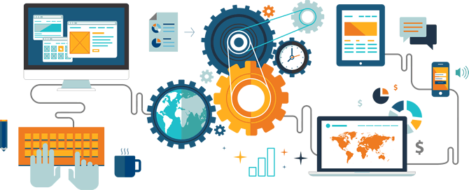
Transforming Organization
through
AUTOMATION
Presented by
Rachit & Abhishek, Skilrock Technologies

Slide 14
Starting Steps in the Transformation
Improving culture & collaboration
Integrating Software Delivery Components
Test automation
Deployment automation
Applications Monitoring
Infrastructure automation and Monitoring

Slide 15

Agile team - One team
Adopted SCRUM as a starting point

Slide 16
Agile
Not just – start taking daily meetings as STAND-UPS
What’s required to change
Thinking ahead (working when planning, Sprint Planning & SoS)
DOR (Ready, before you jump in Dev – Refinement & DOR)
Self Organized (Power to Con….)

Slide 17
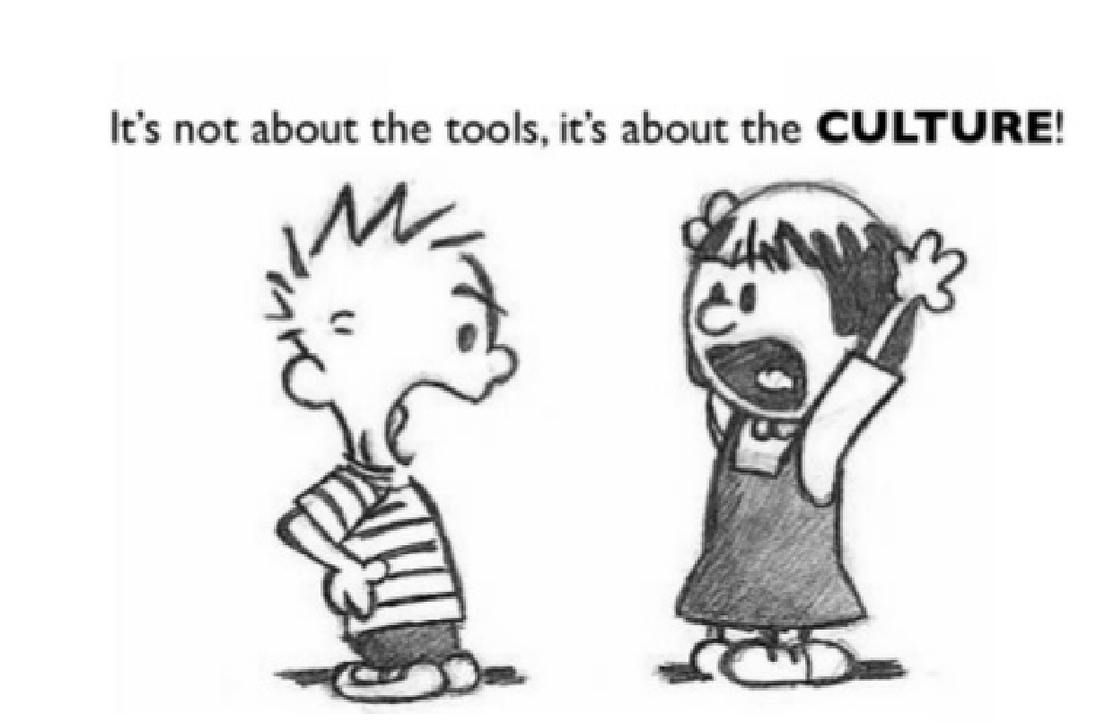
Even Agile emphasises on Individuals and interactions over processes and tools.

Slide 18
Components of Software Delivery
Three Different Components
Release Team waits for QA Approval for final Release
Development
Testing
Operations
(Release And Deployment)
Testers Have to Wait for the for the final commit
Delayed Product Delivery

Slide 19
Devlopment Process
Test Driven Development (TDD)
Unit Test Cases (Junit Framework)
Jocco For code Coverage
Mocking (Mockito)
Code Refactoring
Methods Breakdown
Naimng Convention

Slide 20
Clean cloding practices
Following solid principles
Dependency Injection

Slide 21
Automated Testing
TDD practices
- Started automated unit testing (JUnit)
BDD practices
- Automated acceptance testing
Build up test coverage for regression tests
Test Result Report and Analysis
- Introduced Cucumber for Test Rports
Mobile Application Automation
- Introduced Appium

Slide 22
Operations
Continous Integration
- Sanitized Version Control
- Introduced Jenkins
Deployment Automation
- Deploy to QA/Test/UAT
- Extend CI tool with help of plugins/deployment scripts
- Mechanism to deploy builds+configs+db patches as a package
- Extend monitoring alarms to more teams for proactive measures
- Add application level monitoring using ELK stack

Slide 23
Automated Provisioning
- Introduce a tool like Ansible to automate creation of new environments
- Reduce Environment Rollout time

Slide 24
Integration of Software Delievery Components
Testing
Operations
Devlopment
DevOps

Slide 25







Continuous Integration and Delivery
Artifact Repository
Seleinium
Deployment
Version control
Jenkins
NEXUS OSS
GitLab
Ansible
Continuous Integration
Test Automation
Devlopers
Provisioning
Ansible
Operations
QA-Client A
QA-Client B
QA-Client C

Slide 26
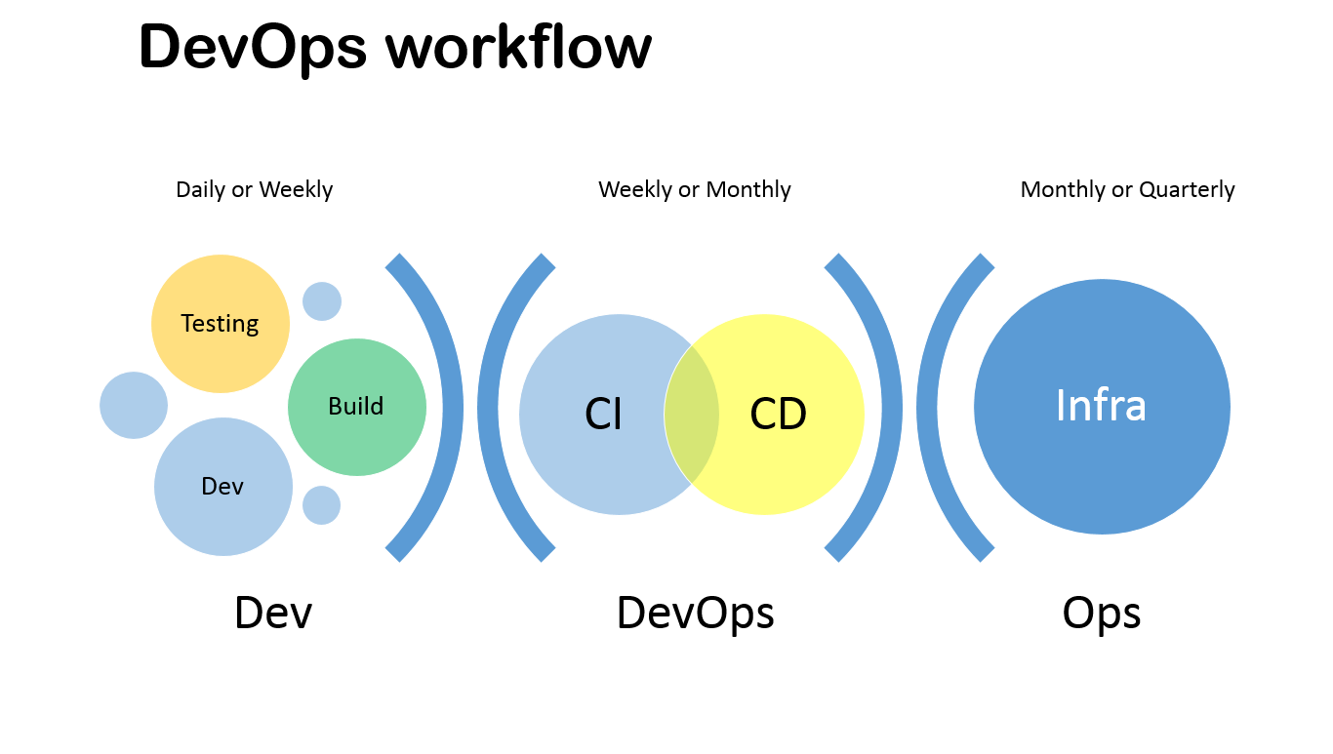

Slide 27
Technical Transition
Common Code For All Clients
Behavior Driven Development (BDD)
Test Driven Devlopment (TDD)
Automated Provisioning
Data Base Versioning
Build Automation
Artifact Management
Automated Deployment on QA
Automated Functuional Testing
Efficient Application Monitoring

Slide 28














Tech Architecture
Version
Control
GSP
Core Transaction Engine
GSP
Log Monitoring & Analytics
Encrypted APIs
Published
Skill Lotto’s
Own Portal
Skill Lotto’s
Mobile App
ASPs
Any Third Party
AS

Slide 29








Current Product Delievery Model
2 week
sprint
Versioning
Code
Database
Pull & Push several times a day
CI
AT
D
D
Version Control
Continuous Integration
Server
Automation Test
Server
Deploy
Server
Target Servers
(QA, Staging)

Slide 30
Tool stack
SCM
Gitlab CE
Agile
JIRA
CI
Jenkins
Maven
Gradle
Repository Manager
Nexus OSS
Unit Testing
JUnit
Mockito
Functional Test Automation
Selenium
Appium
Cucumber
Provisioning and Configuration Management
Ansible
Monitoring
Nagios, Jconsole, ELK
CI

Slide 31
Cultural Transition
Team Autonomy
Cross Funstional Teams
Self Deciplined and Responsible Teams
Refinement Sessions

Slide 32
Expecting everything will change in
a day
, is questionable !!

Slide 33
There is no
Magic
wand
for Transformation!!

Slide 34
After Implementation immediate Hickups…
Human Element
Your managers are not able to digest the shift === Power to Consensuses
If you have experienced team, then You need time to unlearn and
If you have young team, then you need team’s maturity & learning to adapt
Clients also need to change, if they continue to expect the same way… its difficult to change yourself
Working on breaking old roles / habbits
Getting everybody onboard

Slide 35
After Implementation immediate Hickups…
Tech Delivery
Initially the builds will get delayed
Have to live with the legacy code and structure (Dedicated team for catching up with Legacy code)
Two week Sprint becomes problematic – if automation is not done properly (Agile and Automation goes hand in hand) – probably you can start with three or four weeks cycle. And then move to two weeks
You need a separate FACE saving team … by the time core team is changing … (CRM)
Still mostly reactive work
Improving existing CI, CD and implementation for other Projects

Slide 36
Where do we stand today…
TBD

Slide 37
What more to achieve…
TBD

Slide 38

Final takeaways
Automation is a journey,
not a destination

Slide 39
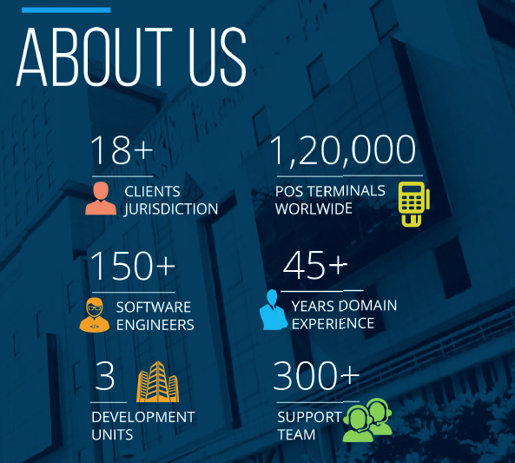


+

Slide 40
+
Back up sides

Slide 41
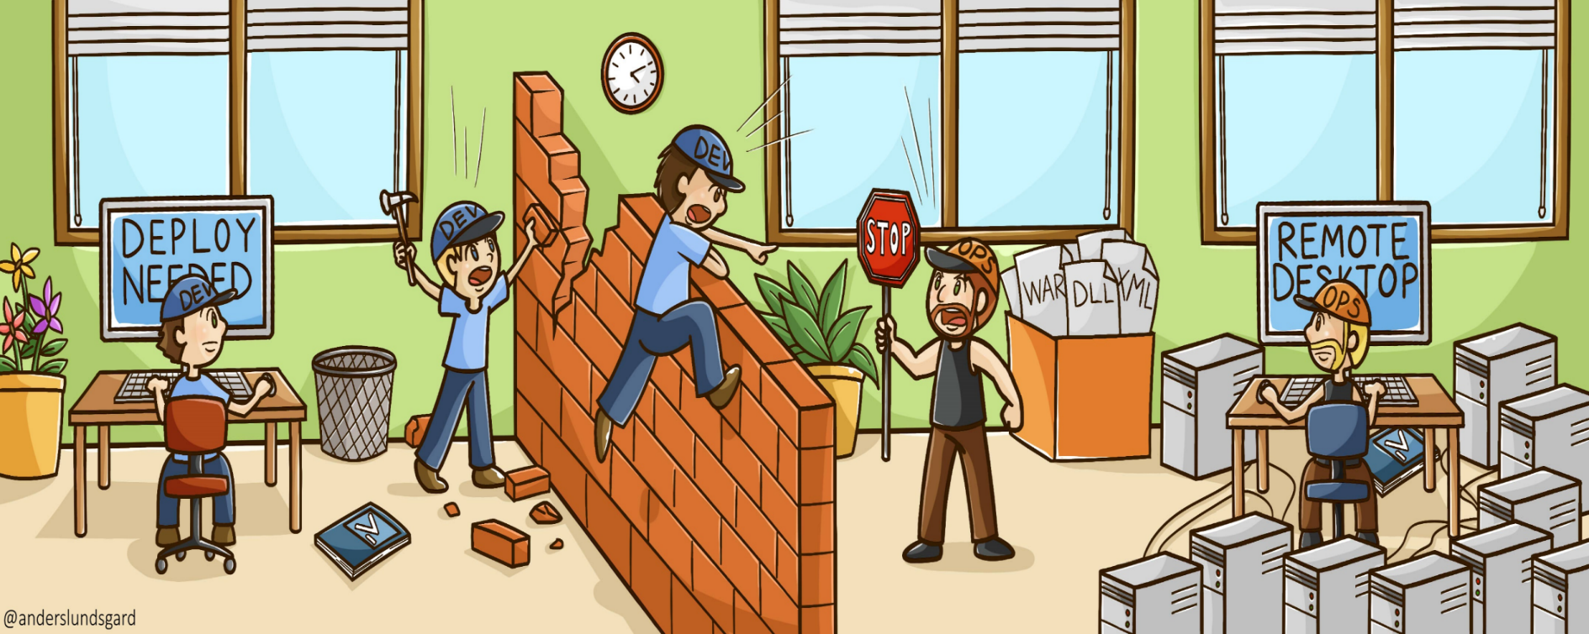
Addressing Challenges in Growing Organization
Dev
Dev
Ops

Slide 42
Knowing your customer
Responsible
Gaming
Security
Mobile Channel

Slide 43
Tech Architecture
GSP
BackOffice
GSP
Core Transaction Engine
GSP
Log Monitoring & Analytics
Encrypted APIs
Published
Skill Lotto’s
Own Portal
Skill Lotto’s
Mobile App
ASPs
Any Third Party
AS

Slide 44
Are these the only key challenges ?

Slide 45
African
^
The challenges of
transformation

Slide 46
Lets set the context right !

Slide 47
GLOBAL
LOCAL
AFRICAN
Responsible Gaming
Know Your Player
Freedom
Power
Connectivity
Cost
Payment
Channel
Content
The challenges of transformation

Slide 48
Innovation Model
Emotional Innovation
People
Desirability
Business
Viability
Technology
Feasibility
Process Innovation
Process Innovation

Slide 49
What Lotteries need?

Slide 50
The Right
Platform
Player Engagement Solution
Solution for
Smart Decisions

Slide 51
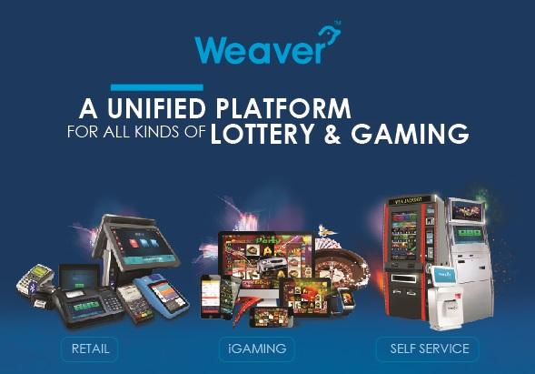

Slide 52

Transforming African Lotteries
3X3 Innovation Model

Slide 53

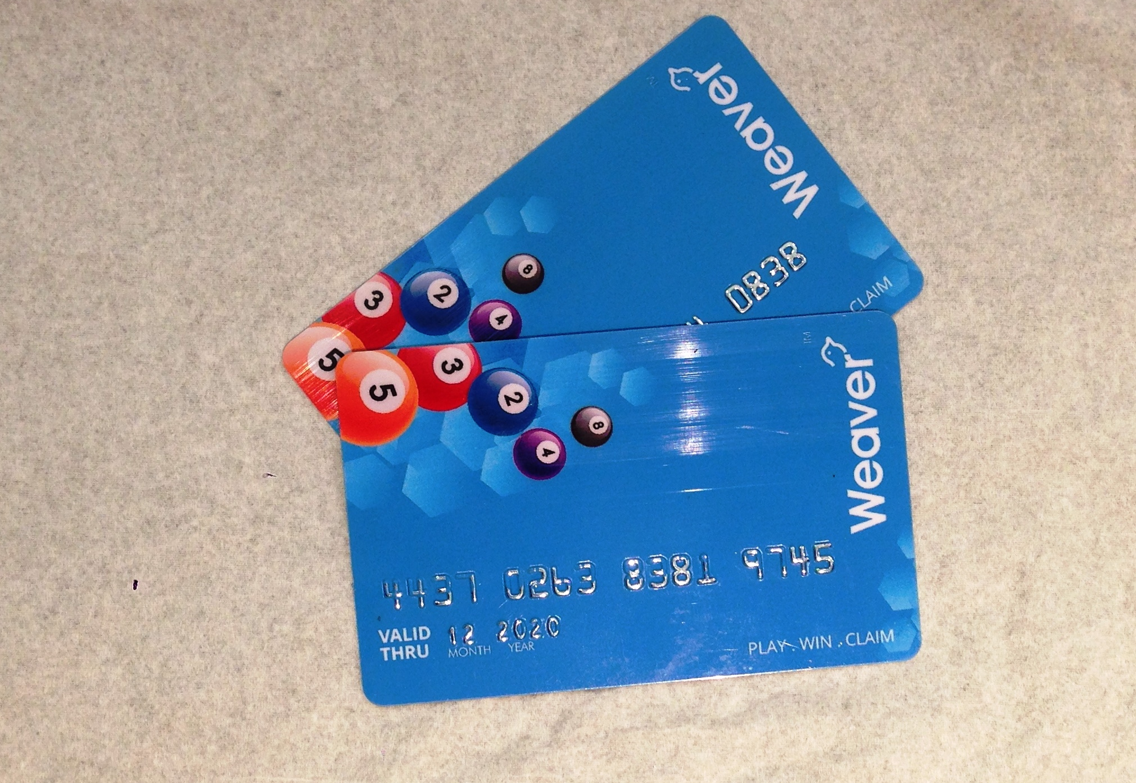
The
CARD

Slide 54
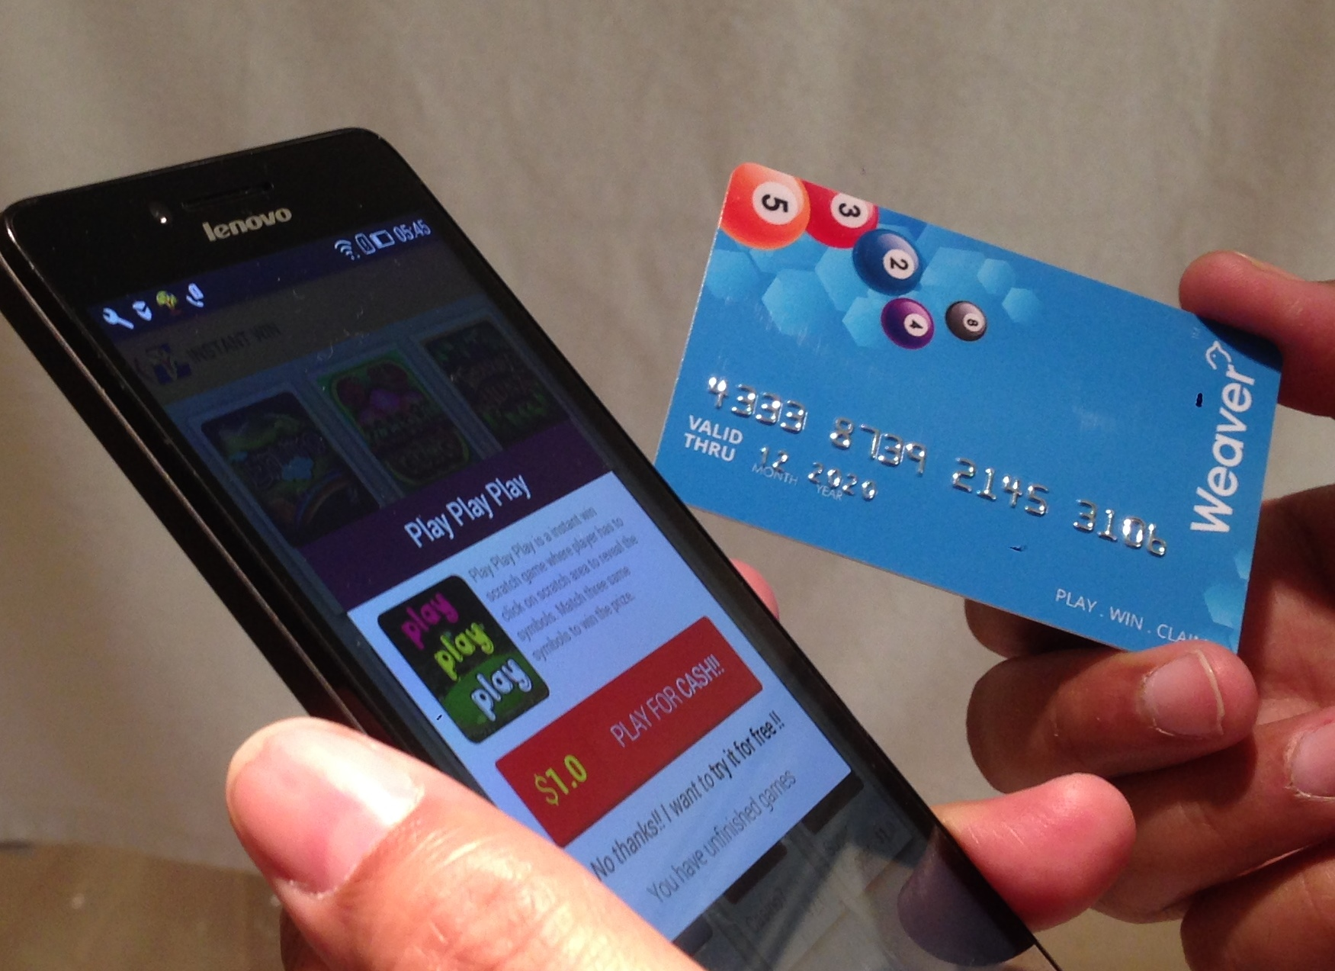
Player WALLET
WEAVER CARD also as wallet to play Mobile Lottery

Slide 55

Smart Decisions

Slide 56
Domain
Knowledge
45 Years of operational experience
Data
Science

Slide 57

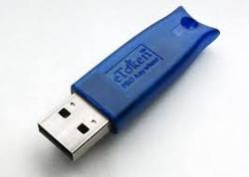

Invoices, Returns, eSign and Recon.
DEMO
Invoice
Invoice & GSTR
(View & Save)
GSTR File with eSign & DSC
1
Issue
an invoice
Skill Lotto’s
ASP Portal
AS
Accounting S/W
2
3
OR
Skill Lotto’s Agent POS
Upload Multiple Invoices (Excel)
Distributor Panel
4
Powered By
Reconciliation & Further GSTR Filing

Slide 58
User Management
DEMO
Tax Payer #1
(Owner of the GSTIN – with registered Mobile No.)
Access Rights assigned through OTP
Tax Payer #n
(Owner of the GSTIN – with registered Mobile No.)
Tax Assistant
Master User
(Master Access Rights of GSTIN is assigned to this user @ GSP)
Sub-User #1
Sub-User #2
…
Sub-User #n
Any set of privileges assigned to a sub-user for any particular set of GSTIN

Slide 59
ANALYTICS
Service
Open Data Analytics
Product
Built around
WEAVER
Platform

Slide 60
Smart Decisions
Data > Information > Knowledge > Decisions
The First Challenge : Collecting the right data and in RIGHT quantity
Analytics is not only for direct player channel, not only to address questions related to what your players are?
It focuses a lot on RETAIL business and the most relevant questions to be addressed are
Product Selling Pattern
Retailer Activity Patterns
Geo Location Distribution Analytics and Optimization
POS Terminal Life Cycle & ROI Analysis

Slide 61


LOTS, Ghana
Skilrock - Introduction
for

Slide 62
Serving 12k+
Retailer across Ghana
Together
Changed
65 year old NLA
Introduced
New
Products

Slide 63


Slide 64

Added lot more Teams
& adding
more !

Slide 65

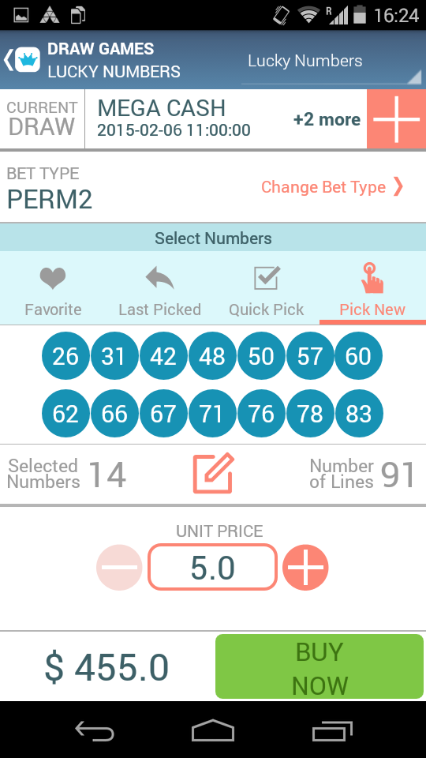
Changed
focus to
Mobile

Slide 66
& a lot more
CONFIDENTIAL
stuff

Slide 67

Lets go formal !

Slide 68
Technology Platform
Background
Private & Confidential

Slide 69



India Lottery Operations
Sugal & Damani Group (Skilrock’s Parent Group) is operating lotteries in India for more than 45 years
Holds market leader position with 65%+ Market share.
Runs 25,000+ POS Terminals
Conducts 15 Million transactions per day.
Up to 300 daily draws
Touches 400 million population
Private & Confidential

Slide 70
